Slide 1
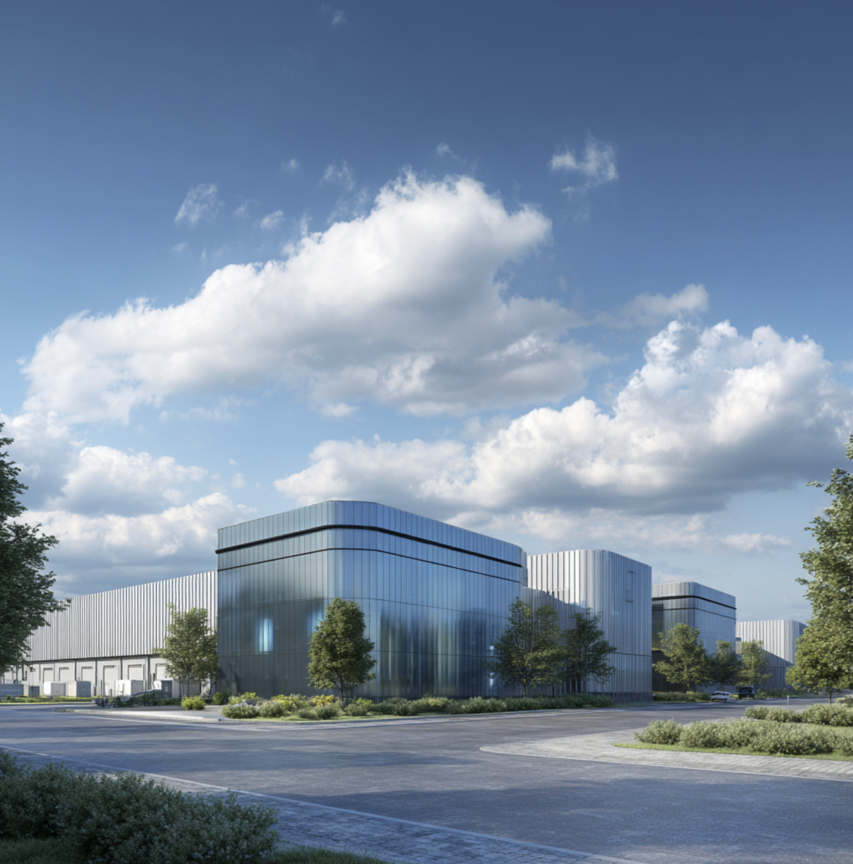
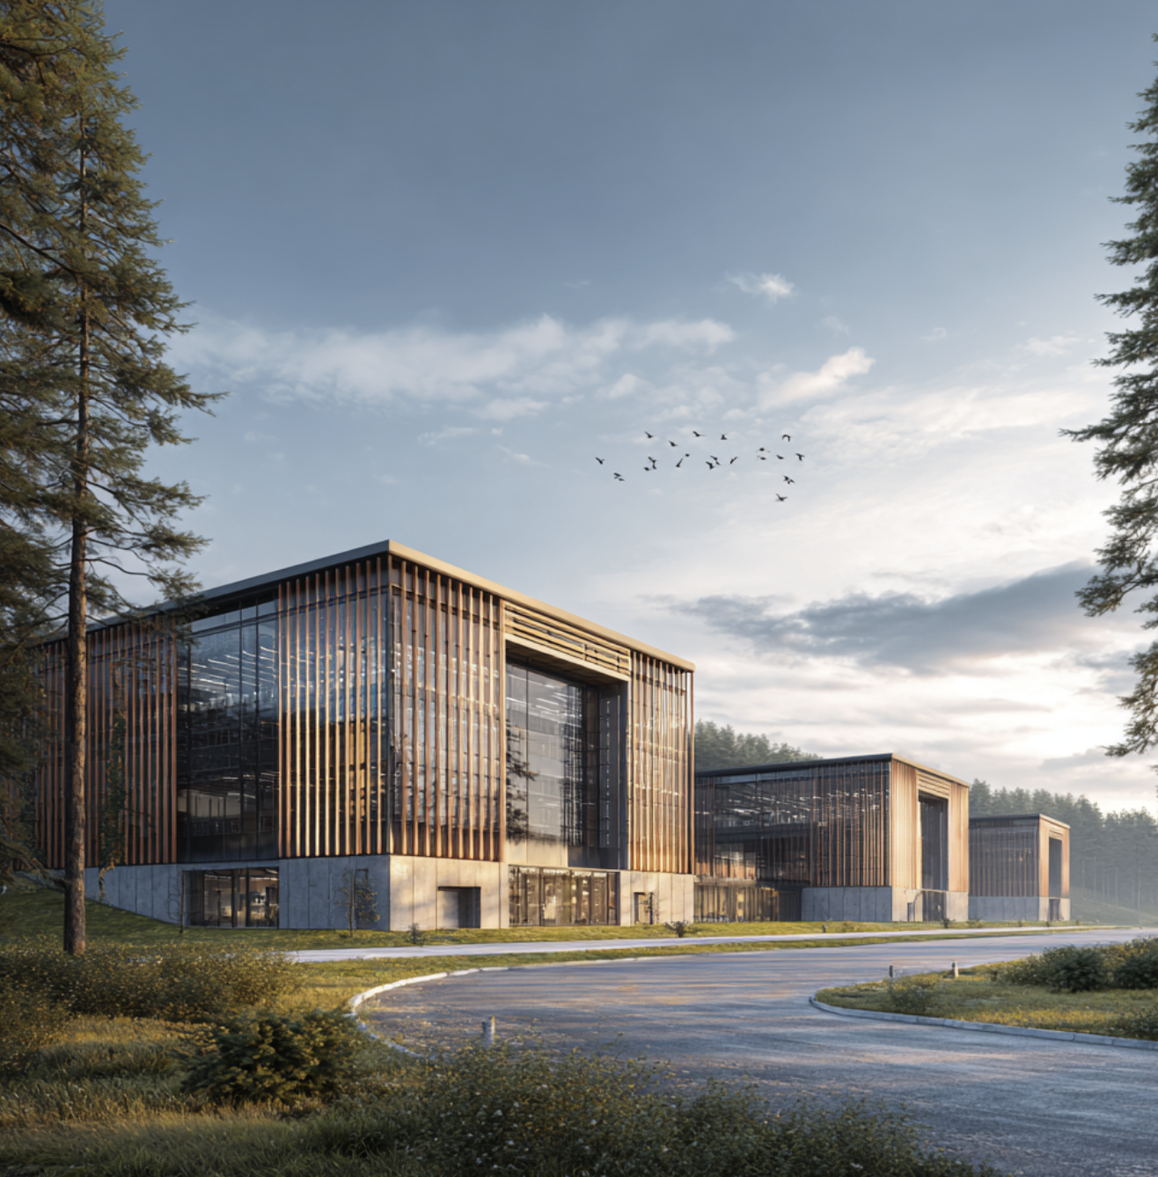
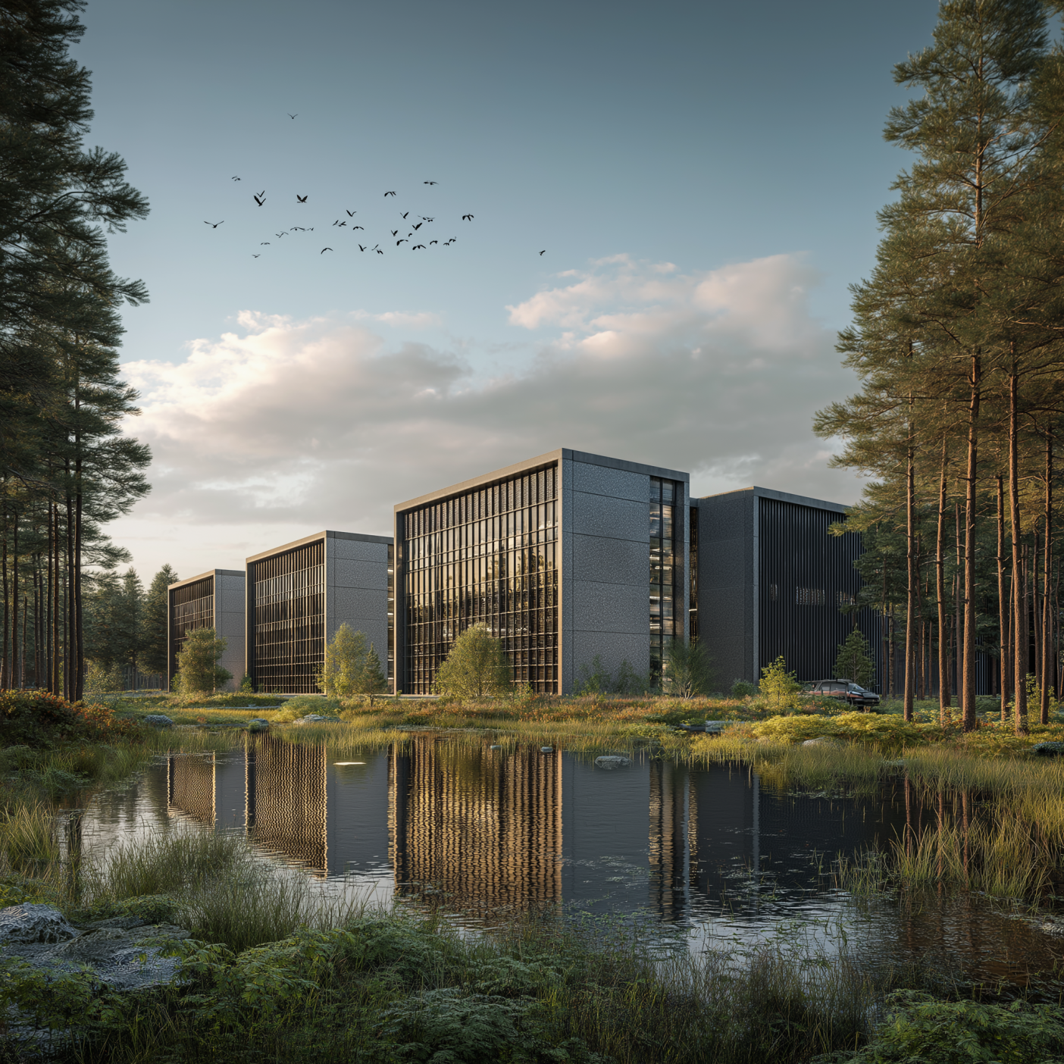

DC Opportunity
Sochaux
Confidential

Slide 2
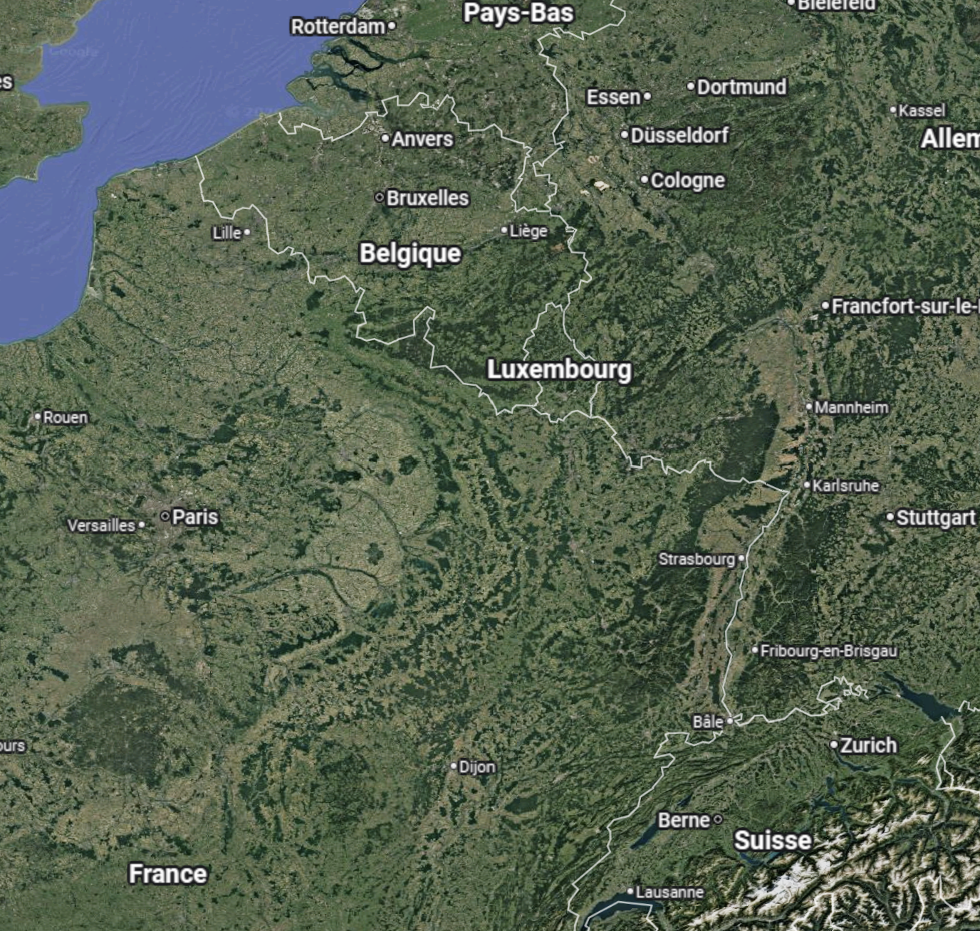

Location
Comments
Distance from Strasbourg: 120 km Distance from Frankfurt am Main: 320 km Distance from Paris: 360 km
https://www.google.com/

Slide 3
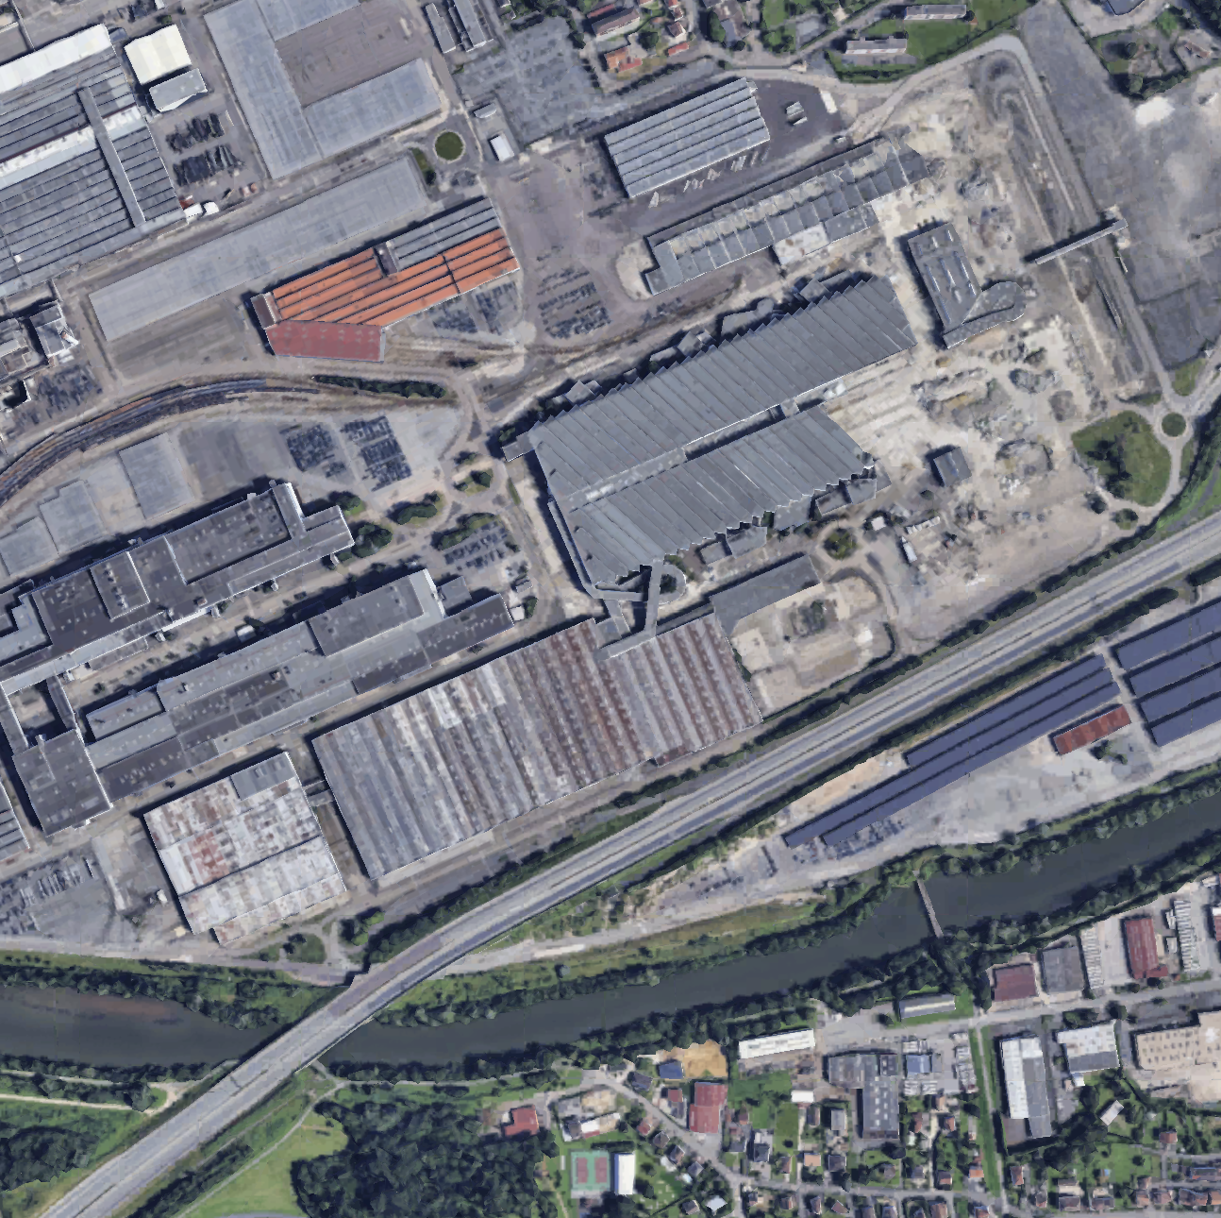
Landplot
Comments
Land plot: c. 35 ha

Slide 4
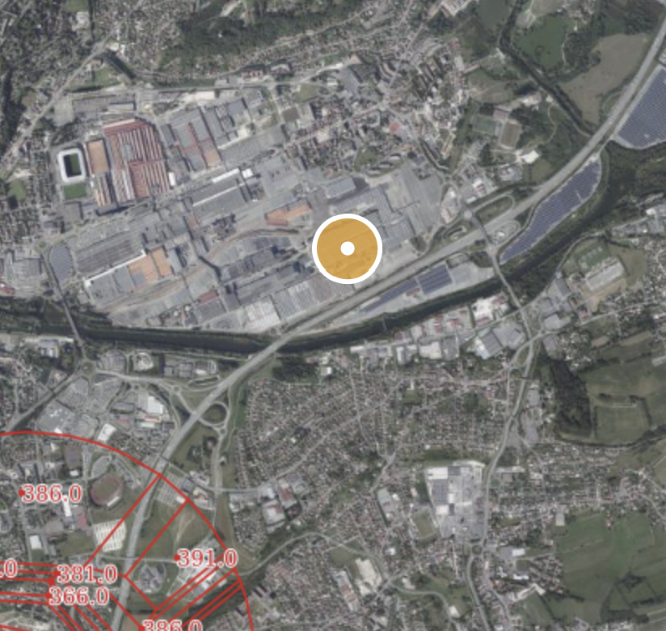
Airports
Comments
Land plot outside any aeronautical easement
Pas de risque aérien

Slide 5
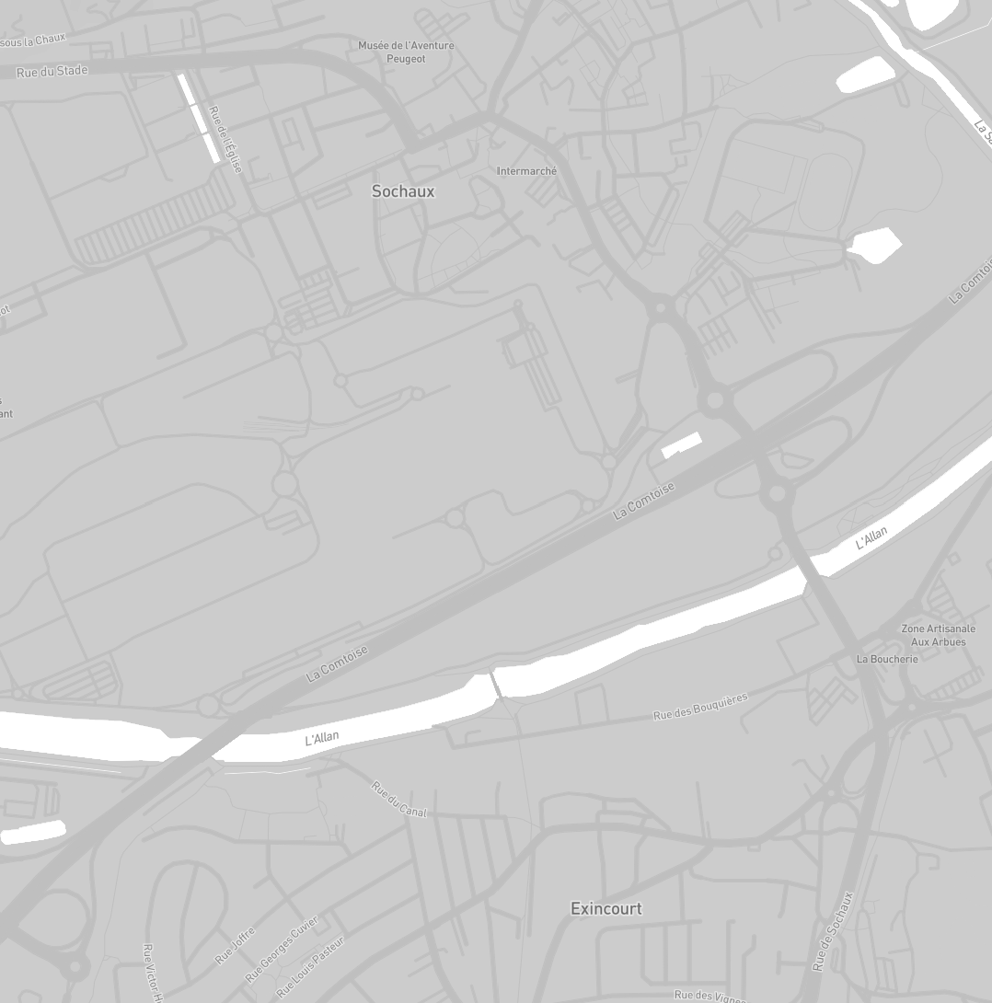
Connectivity
Comments
The site is very close to major fiber backbone (50 m distance)

Slide 6
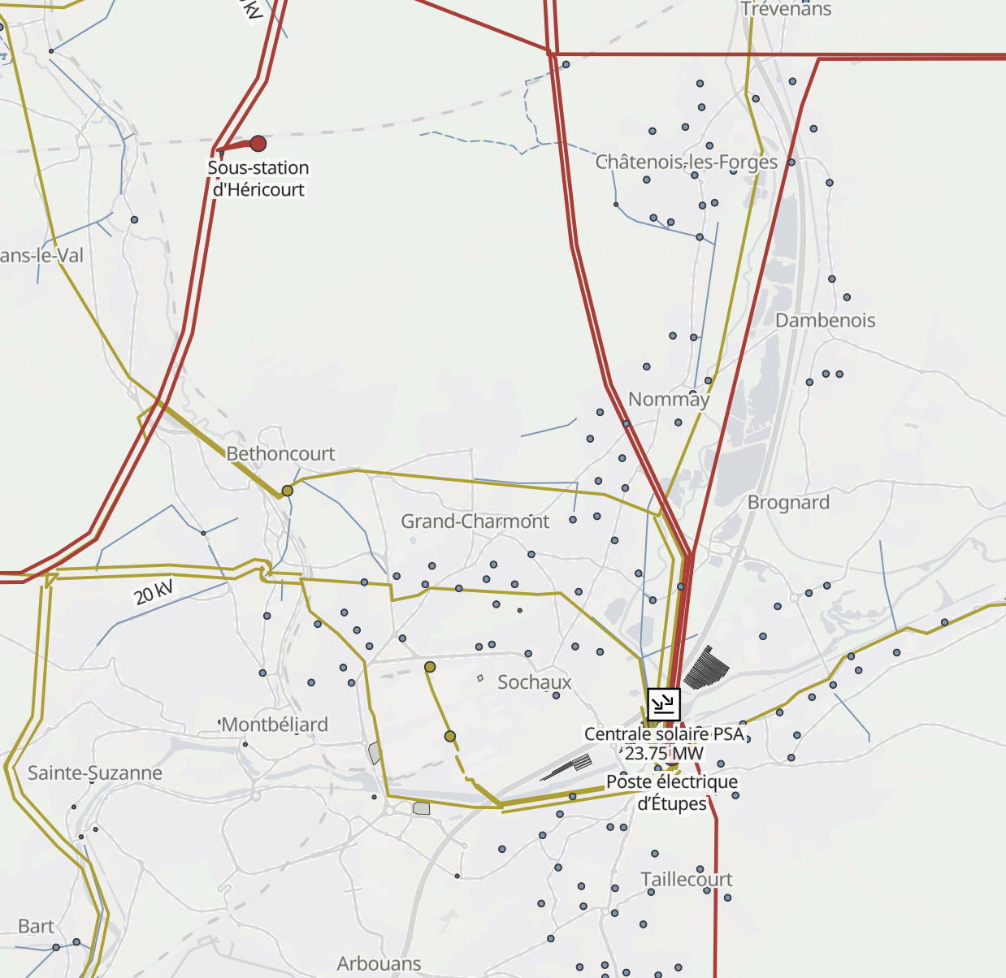
Power environment
3
Comments
The site offers diversified power connection options 1 – 63KV substation (450 m distance) 2 – Étupes 225KV substation (1.9 km distance) 3 – Héricourt 225KV substation (6 km distance)
1
2

Slide 7
Environmental Risks

Slide 8
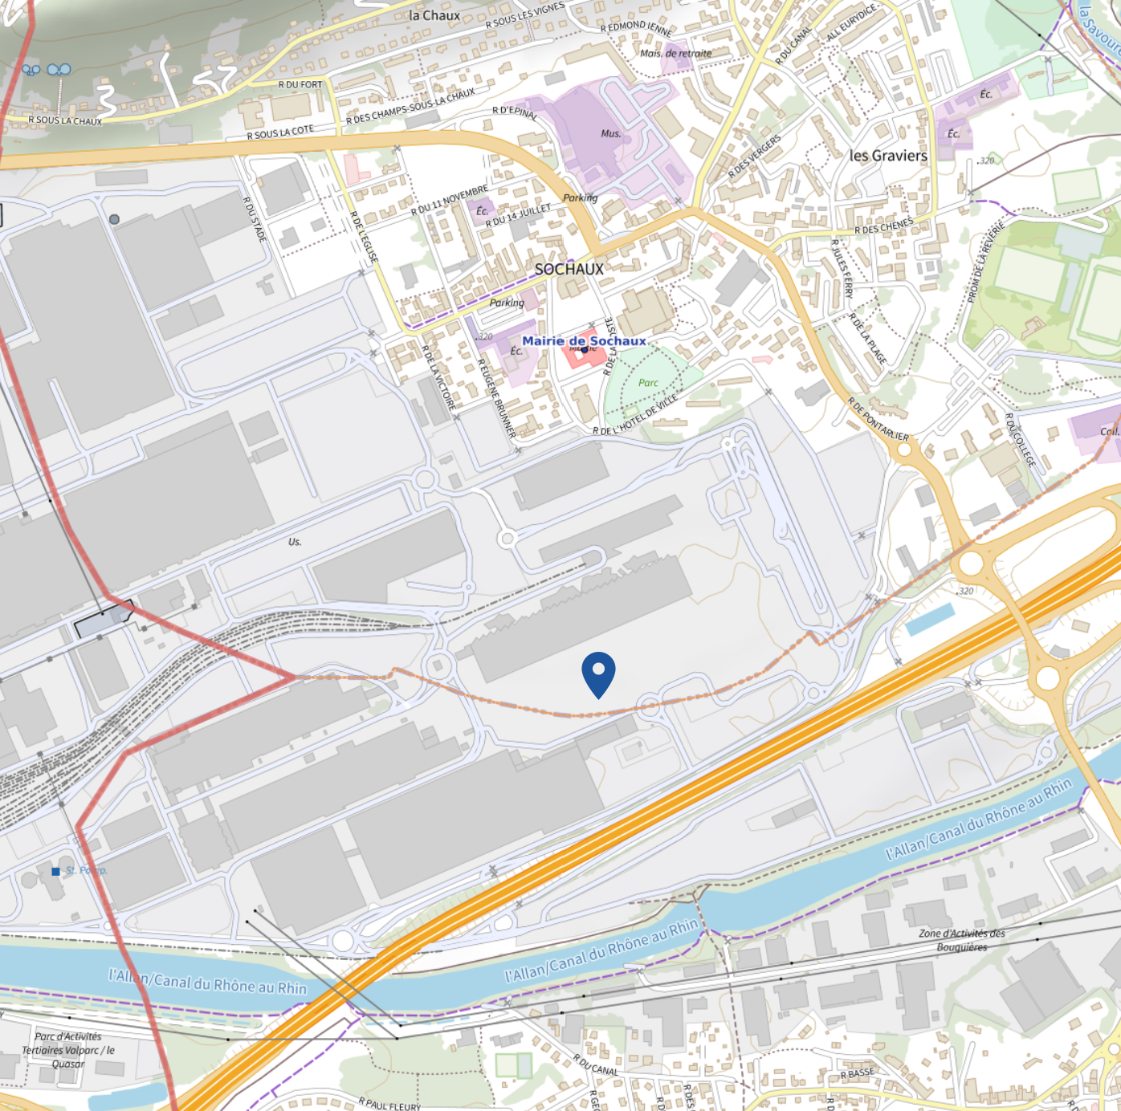
Technological & Chemical Risk
Comments
No SEVESO high-threshold sites in close proximity <1.5 km
*^*

Slide 9
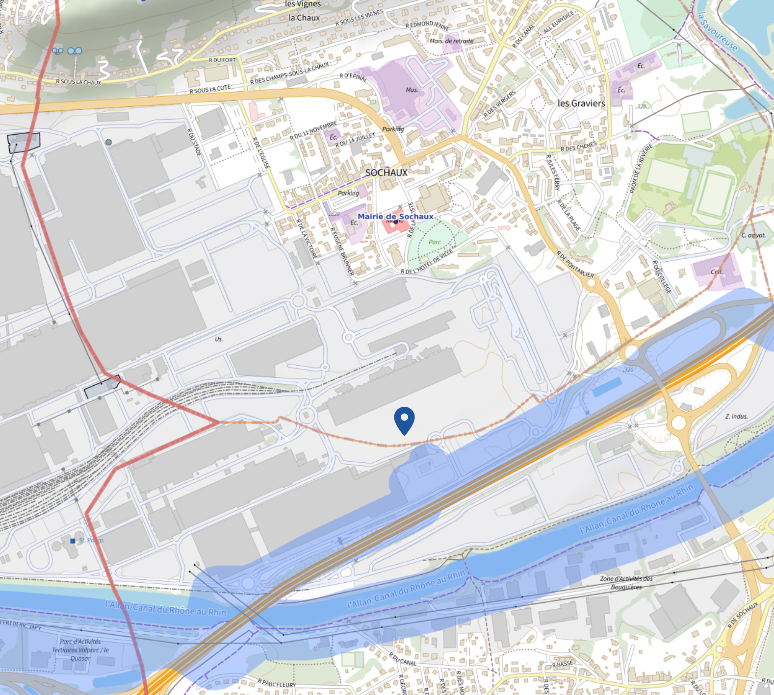
Technological Risks
Comments
Land plot mainly impacted by hydrocarbon and gas pipeline

Slide 10
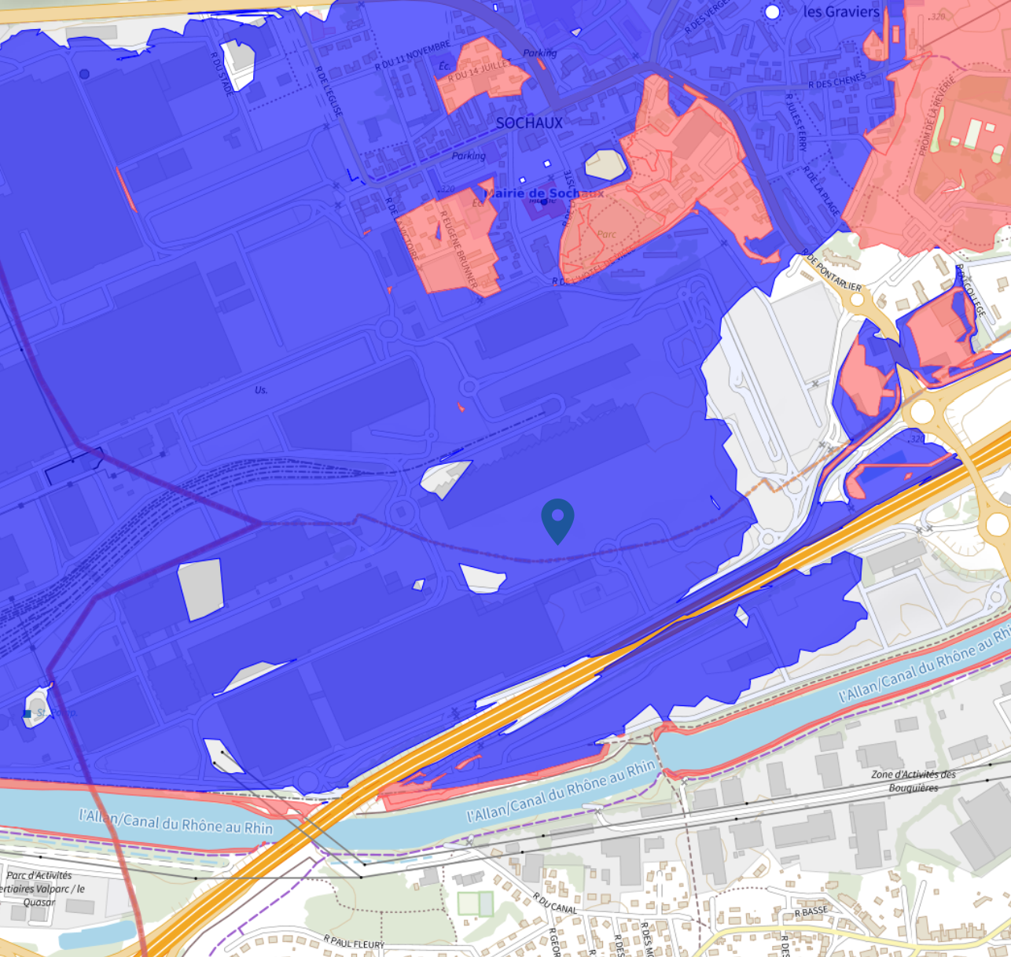
Flood risk
Comments
Land plot 100% within the pipeline prescription zone Flood reference level (PPRi) ≈ 319.4 m NGF Target: ground floor set at 320 m NGF (reference level + safety margin)

Slide 11
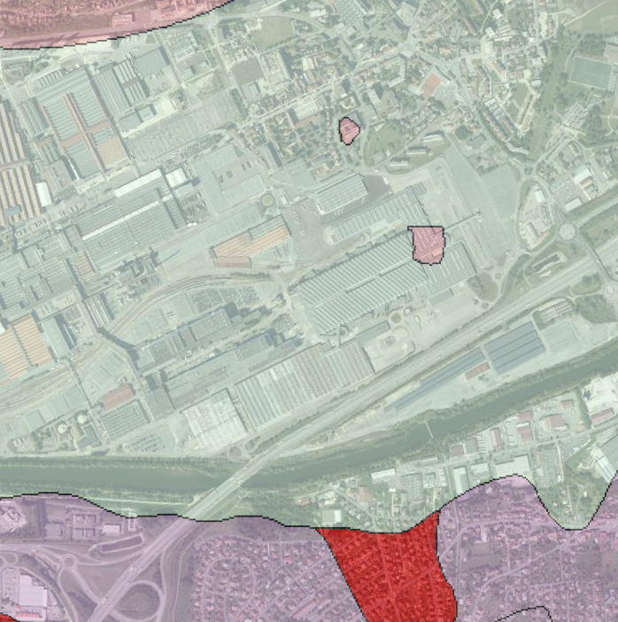
Soil
Comments
Marls containing Helix and Mytilus, sandstone, conglomerates and lacustrine limestones (Ludian) Recent undifferentiated alluvial deposits, gravel, sand and clay

Slide 12
Local urban development analysis (PLU)

Slide 13
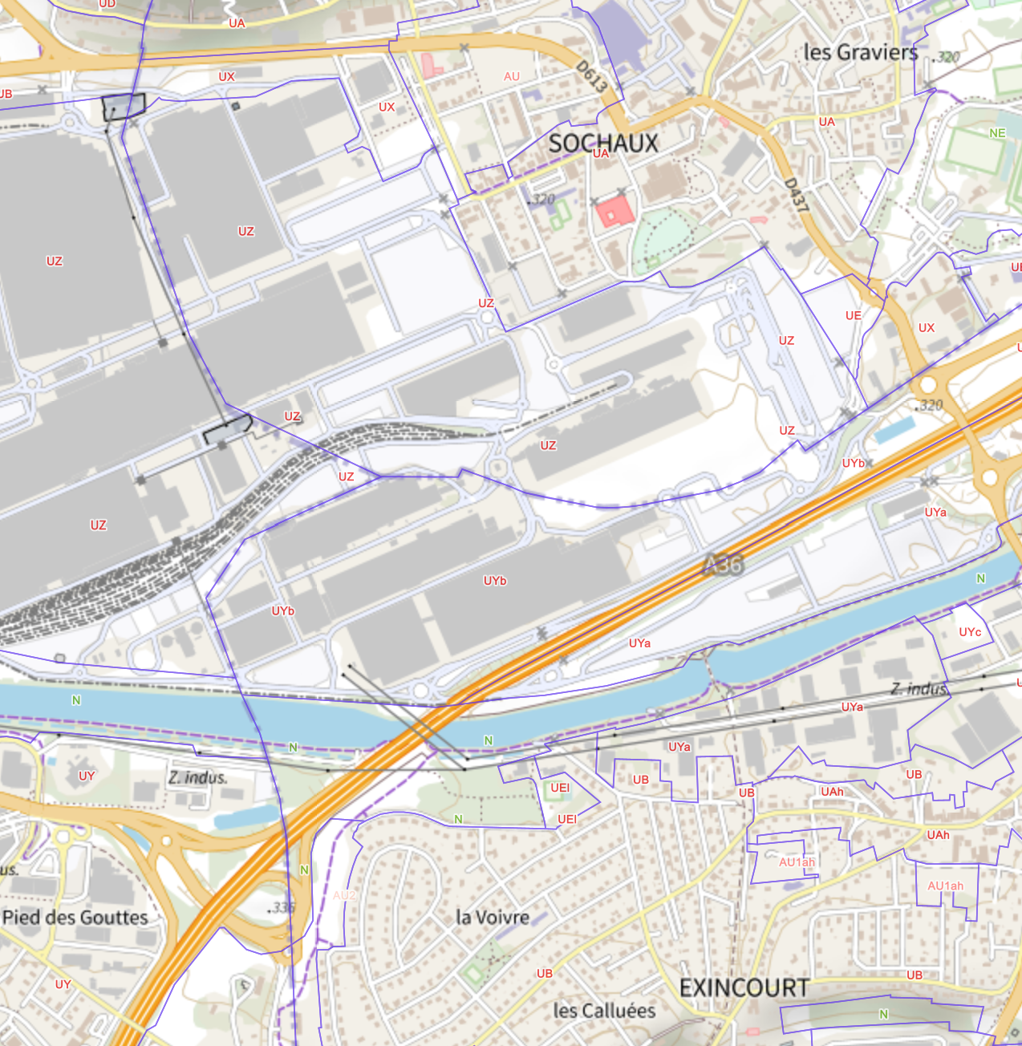
PLU analysis
Comments
Land plot located in UZ and UYb areas UZ : Industrial estate UYb : Sites intended primarily for industrial activities

Slide 14
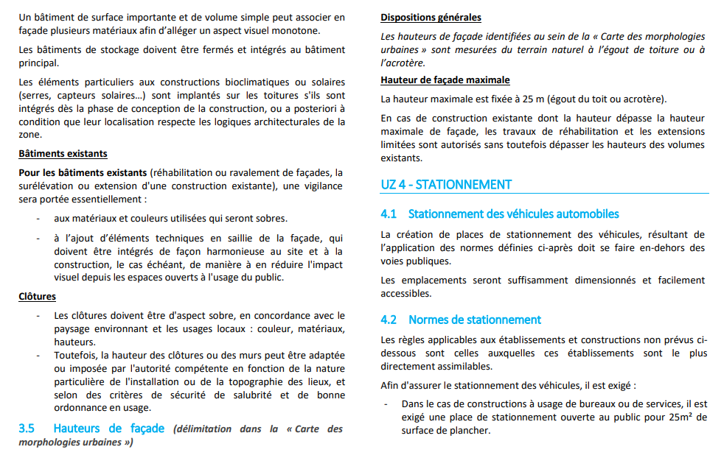
PLU analysis
Comments: UZ area
Footprint: No specific floor area Height: max 25 m

Slide 15
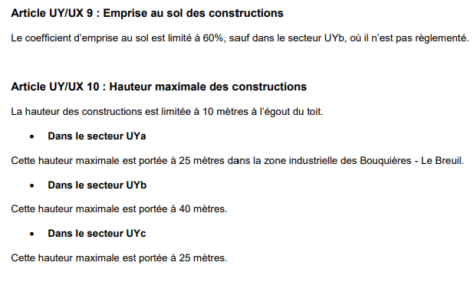
PLU analysis
Comments: UYb area
Footprint: unregulated Height: max 40 m

Slide 16
Macro Sizing

Slide 17
PLU analysis
Comments: Considering gas prescription zone
Land plot: c. 35 ha land area DC building: 62 500 sqm footprint 1 level building 7 m with 5 m technical roof IT load per building: 250 MW Total power per building: 350 MW Landplot total: 350 MW
RTE
RTE
UZ
DC
UYb

